Slide 2
Notes to the Presenter
Slides 4-10 contain notes for the presenter and are hidden.
You may include your picture and company logo on one slide only
It is appropriate to provide a brief background (1 minute or less) on your organization.

Slide 3
Presentation Best Practices
Frame your presentation by answering:
What do you want your audience to learn?
What do you want your audience to do differently?
What result or outcomes do you want your audience to realize?
Clarify your session objectives at the beginning of your presentation.

Slide 4
Presentation Best Practices
A picture is worth a thousands word. A good goals is to aim for 7 words per slide.
Increase attention and interaction by using a variety of communication mediums, such as polls and videos.
Inform PowerBIUG team of plans if using videos, audio, etc. to ensure appropriate AV & room arrangements are made
Plan and follow a rough agenda including a breakdown by minute to help stay on track.

Slide 5
Example of Text Layout
Main topic 1: size 28pt
Size 24pt for the subtopics
Size 24pt for the subtopics
Main topic 2: size 28pt
Size 24pt for the subtopics
Size 24pt for the subtopics
Main topic 3: size 28pt
Size 24pt for the subtopics
Size 24pt for the subtopics

Slide 6
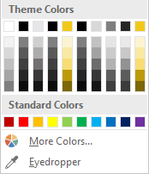
Slide Palette Info
The PowerPoint palette for this template has been built for you and is shown below. Avoid using too many colors in your presentation.
Select the 4th color from the left for subheads and 1st level non-bulleted text color, or wherever “color” text is preferred over the default black/white text
Accent colors 1-6 – (6 Theme Colors to the far right)
Text
Dark 2
Accent 1
Accent 2
Accent 3
Accent 4
Accent 5
Accent 6
Use Accent 1 as the main accent color. Use Accent 2 and Accent 3 when additional colors are needed.
Use Accents 4-6 sparingly – only when more colors are necessary.

Slide 7
Chart Example

Slide 8
Lots of data? Minimalize
Gray is used to de-emphasize data that is less important. Use cool gray 3 or cool gray 7. See slide 7 for color formulas.
All elements have the same interior margins as text blocks.
When a chart or graphic, has more elements than can easily be aligned to the grid, align the outer edges of the group, top, bottom, left and right edges to the grid.
It is preferable to keep the group aligned to the left border.
130M
140M
125M
Other
Other
Other
Other
Other
Other

Slide 9
Chart Example

Slide 10
Notes (hidden)
Some speakers at Microsoft like to use this slide for hidden “notes slides”.
Delete it if you don’t want to use it.
Next: <next slide title>

Slide 11

Spatial Data Analysis in Power BI
Tony McGovern

Slide 12

Session Agenda
Understand How Power BI Can Help Your Workflow
See How to Incorporate R within Power BI
See the Breadth of Spatial Analytics Available in Power BI
Notes:
Create beautiful thematic maps in Power BI
Understand what out of the box tools are available to enhance analysis

Slide 13


Tony McGovern
Hacker. Artist. Storyteller. Data lover.
Data Scientist
emdata.ai
http://github.com/tonmcg/
@tonmcg
Notes:
Data Scientist at emdata
We love Power BI helps us easily build impactful data applications that we allow us to scale at a fraction of the time, energy, and cost
And we love working with organizations that are making a difference in the world -- for us Power BI is the way for everyone to do more, better

Slide 14
What Can Power BI Do?

Slide 15

Understand How Power BI Can Help Your Workflow

Slide 16
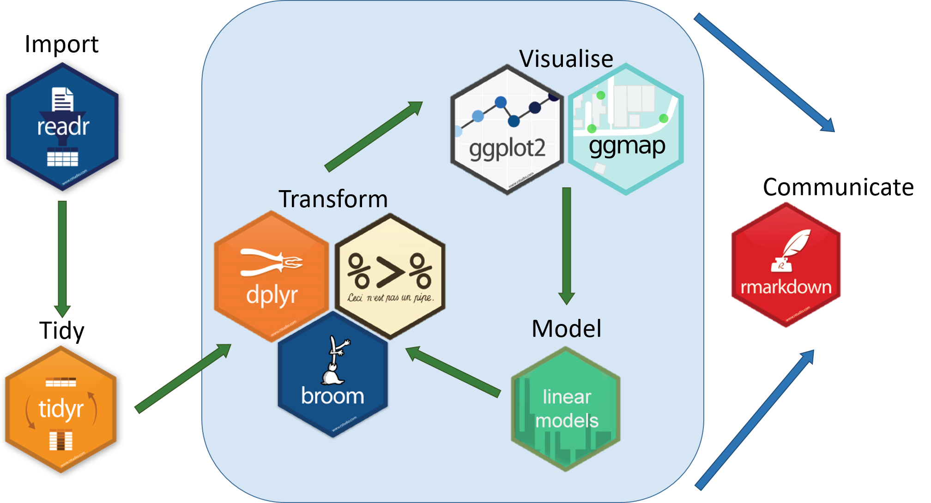
Simple Spatial Data Workflow in R

Slide 17
How Can Power BI Help?
Notes:
What Does Power BI Do Exceptionally Well?
Data Connectivity & Ingestion
Access data stored in hundreds of data sources through a clickable interface
Data Preparation
Allows users to apply over 350 different data transformations by previewing data and selecting transformations in the user interface.
Data transformation are consistent across all data sources and steps are recorded so users see a history of transformations
Data Query Extensions
Power Query comes with its own highly-intuitive data mashup language that can be customized

Slide 18
See How to Incorporate R within Power BI

Slide 19
See the Breadth of Spatial Analytics Available in Power BI

Slide 20
Resources
Mapbox Visual https://www.mapbox.com/help/power-bi-choropleth-map/
Mapbox Studio https://www.mapbox.com/studio/
Azure Machine Learning Studio https://studio.azureml.net/
Socrata Open Data API
https://dev.socrata.com/
Build and Deploy Models as Predictive Experiments in Azure ML Studio
https://docs.microsoft.com/en-us/azure/machine-learning/studio/walkthrough-develop-predictive-solution
Notes:
Create beautiful thematic maps in Power BI
Use those maps for impactful spatial analysis
Understand how to mix in machine learning to your Power BI reports

Slide 21
Questions?

